Slide 1
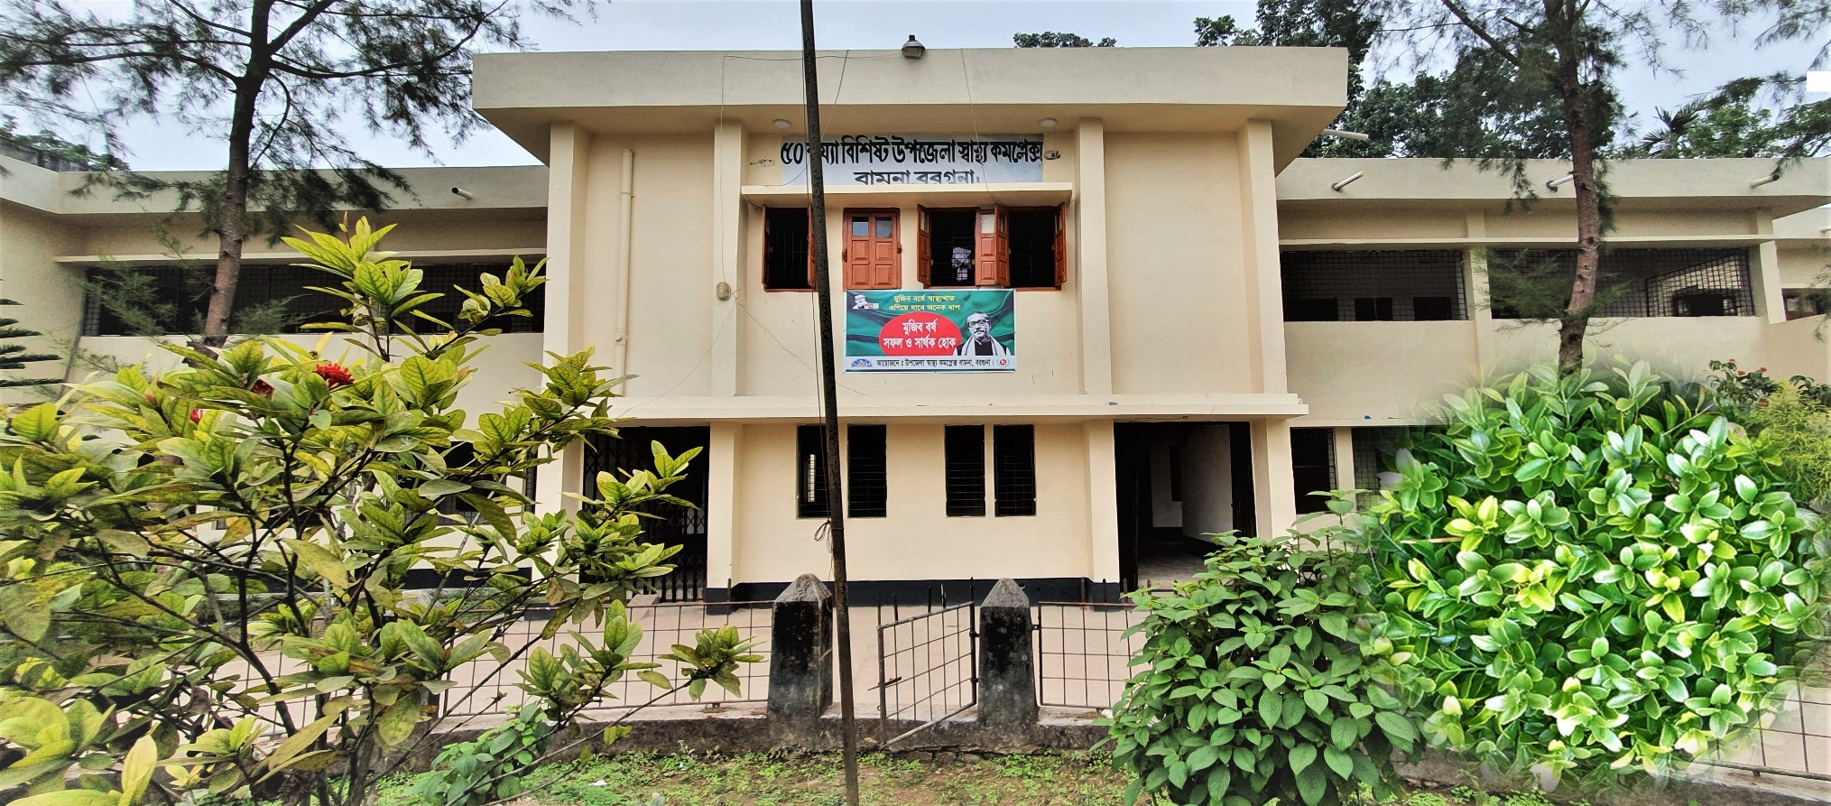
50 BEDED UPAZILA HEALTH COMPLEX
Bamna, Barguna.

Slide 2
Health Profile of Bamna Upazila- 2021
Total population : 94036
Total Fertile Couples : 15055
Total Pregnant : 2176
Total Delivery : 1718
Total Live birth : 1715
Total death : 268
Total Maternal death : 02
Health Man power
a. Doctor : 12 ( 6 + 6)
b. Nurse : 24
c. HA : 19
d. CSBA : 15 ( 6HA+ 7 FWA+2 CHCP )
e. Volunteer, Security guard & cleaner: 06
9. Health Institutions
a. Health Complex : 01
b. H & FWC : 03 ( FWC– 3 )
c. Community clinic : 09
d. Non- Govt. Clinic : 05

Slide 3
10. Mother Taken-ANC : 95% ( 1st Visit)
11. Hospital Delivery Rate : 45%
12. No. of Hospital bed : 50
13. Bed Occupancy Rate : 83%

Slide 4
A Sub-district level Hospital with a Vision
Maximum utilization of Govt.
resources with
honesty and sincerity
Integrated approach of
Administration, Community
Leaders & Health
Management
Providing Effective and
prompt services
through improved
management system

Slide 5
Background History of MCH & Others services of Bamna Health Complex, Barguna
To reduce Maternal and Child Mortality and Mobility and to ensure the quality services to the mother and child, UHFPO opened special activities.
Special activities:
ANC-Corner
Basic EOC service
Under 5 corner for under 5 children
Regular VIA Test
Monthly birth and death record
Others Special activities:
*Adolescents Friendly Health Corner, * ORT Corner
*NCD corner, * IMCI Corner

Slide 6
Contd.
Form 2014 started Comprehensive EOC program.
From 2020 Safe Blood Transfusion unit established in Bamna hospital.
Hospital is 50 bedded hospital by Honorable Prime Minister Sheikh Hasina.
Major Killer Disease (diabetes, hypertension, cancer, RTA & poisoning) prevention program starts in 1st January-2011.

Slide 7

UHC
Bed Occupancy Rate from 2017 to 2021

Slide 8
Emergency & Out Door, Indoor Service 2017 to 2022
BAMNA UHC

Slide 9
Comparative data of revenue income (in Taka) from 2019 to 2021
BAMNA UHC

Slide 10
Upazila Health Complex
BAMNA , BARGUNA.
EOC Activities : 2013- 2022 (Hospital Delivery )

Slide 11
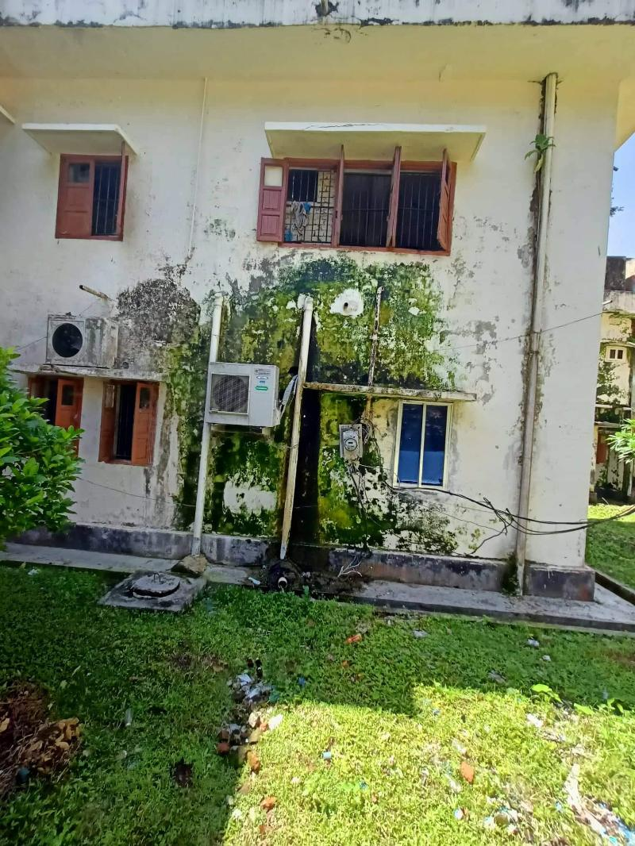
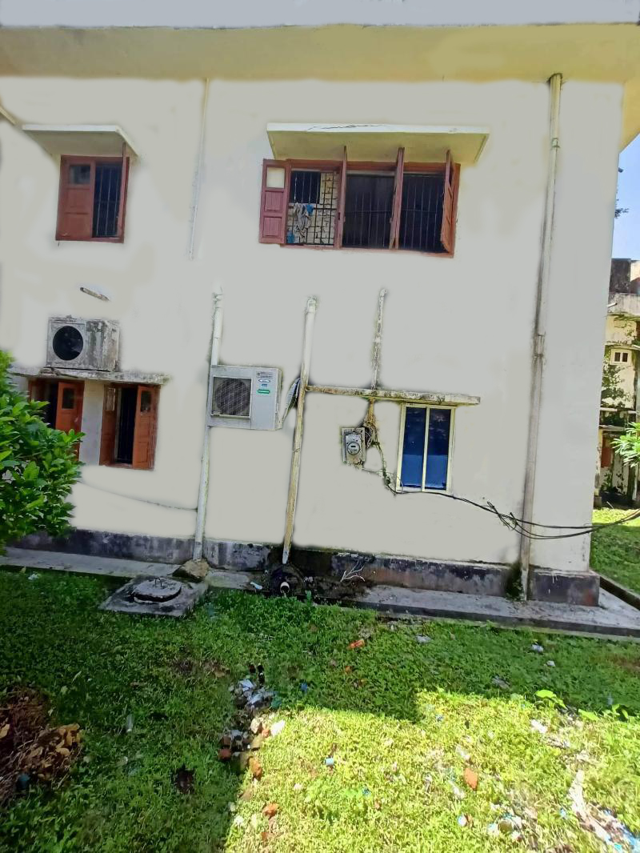
wall and shades of UHC building
Before
After

Slide 12
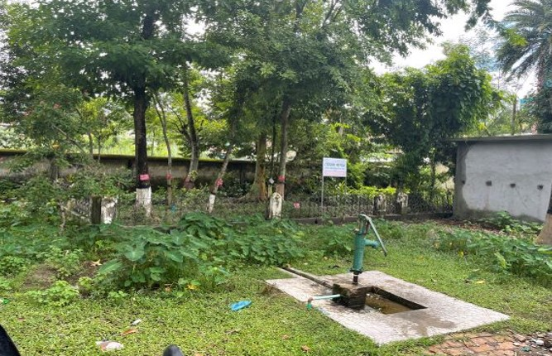
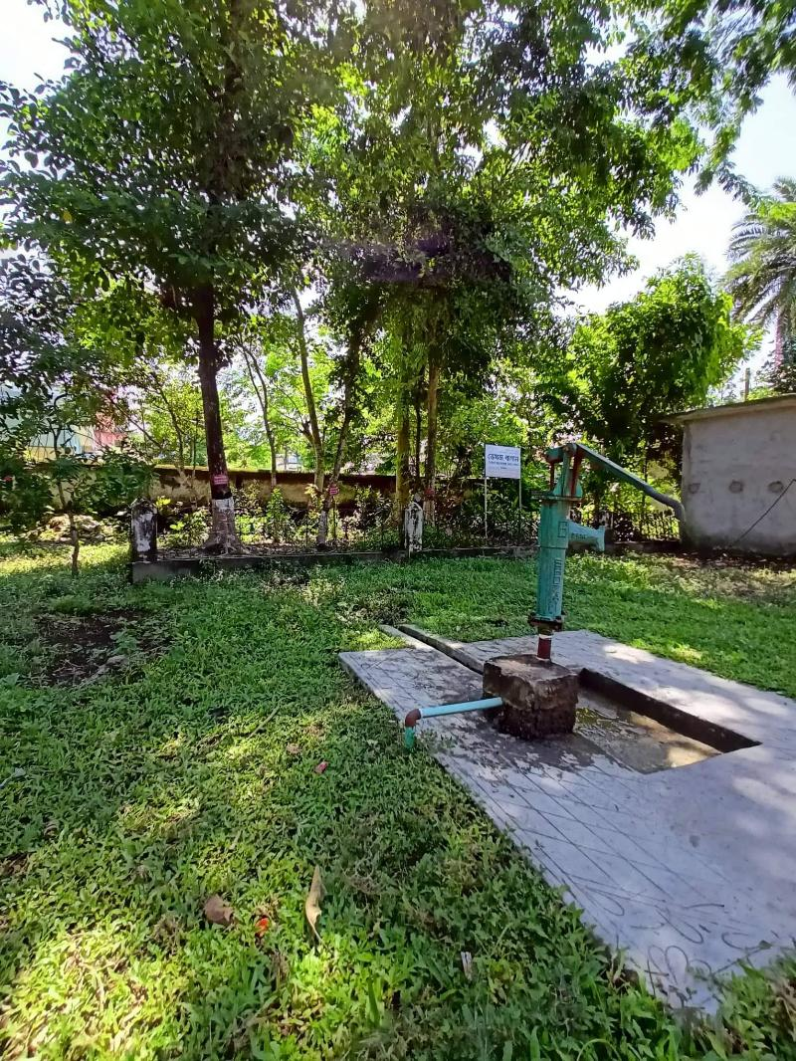
UHC Campus
Before
After

Slide 13
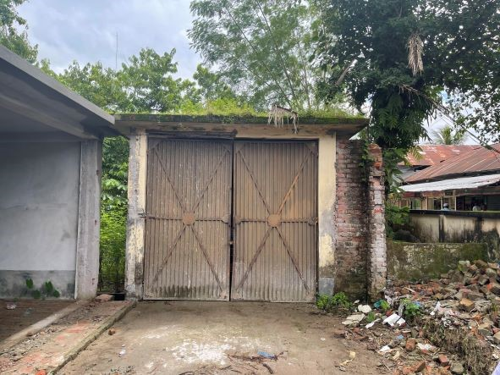
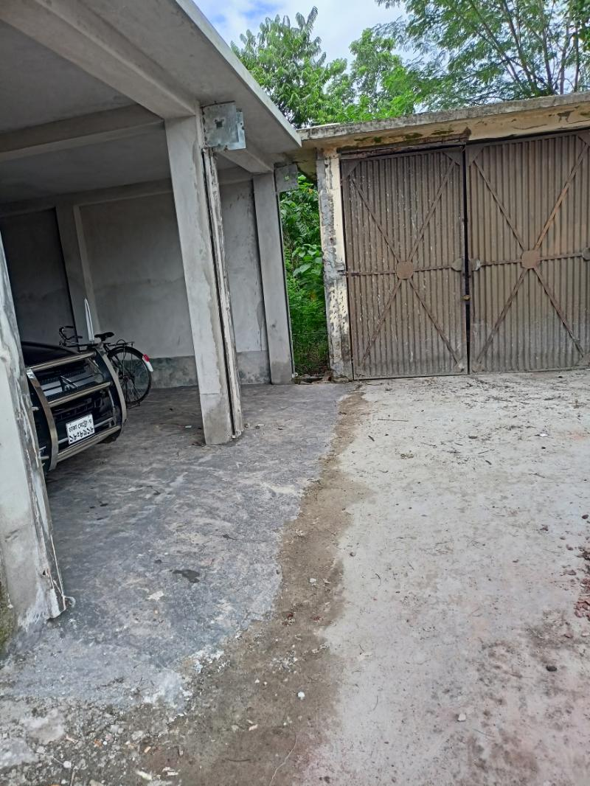
Ambulance Garage
Before
After

Slide 14
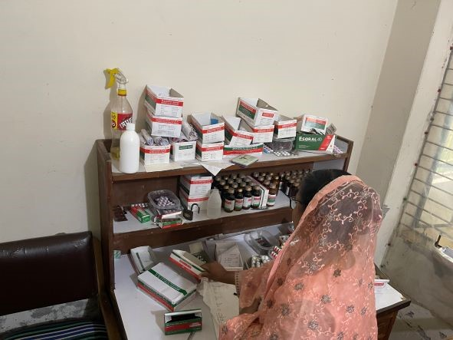
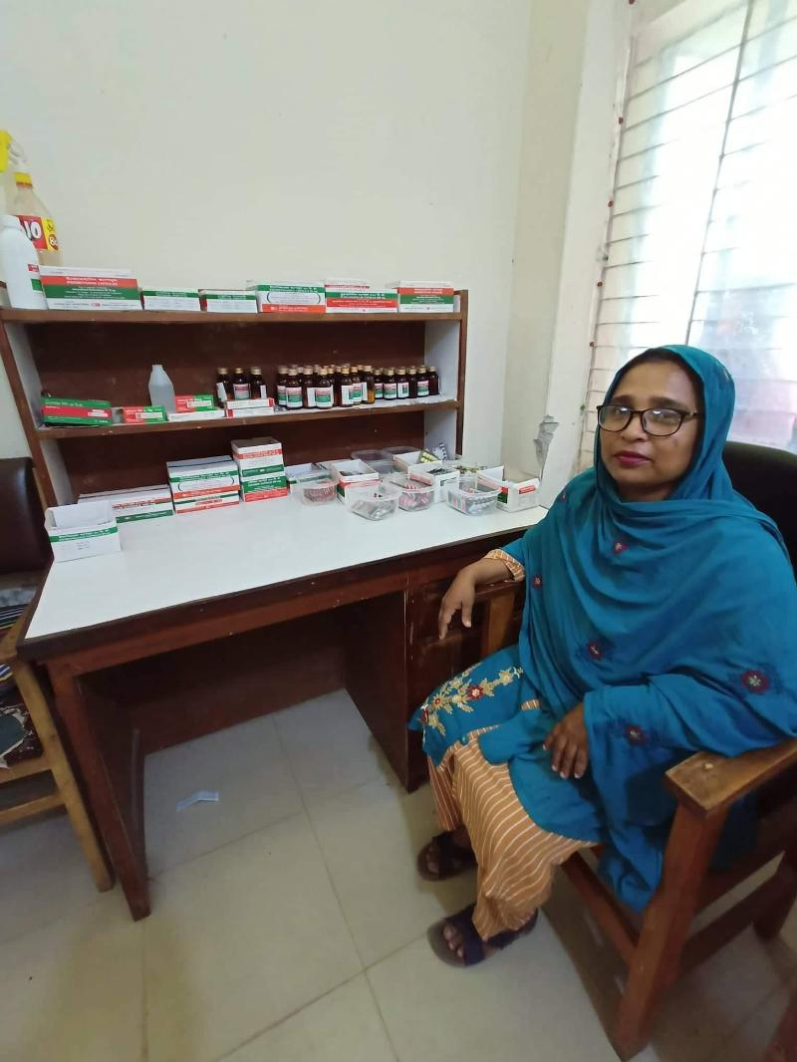
Pharmacy of UHC
Before
After

Slide 15
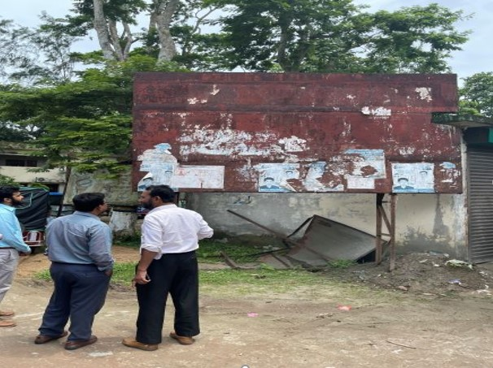
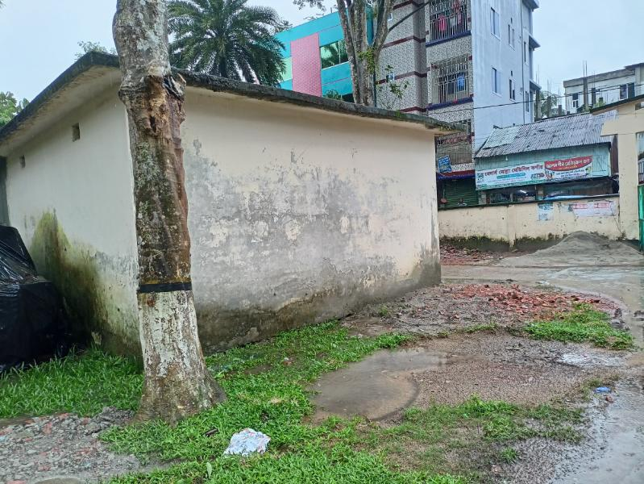
Billboard of UHC
Before
After

Slide 16
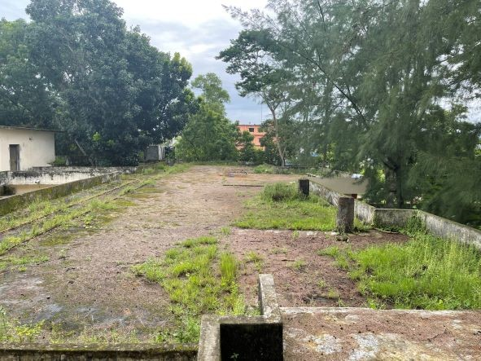
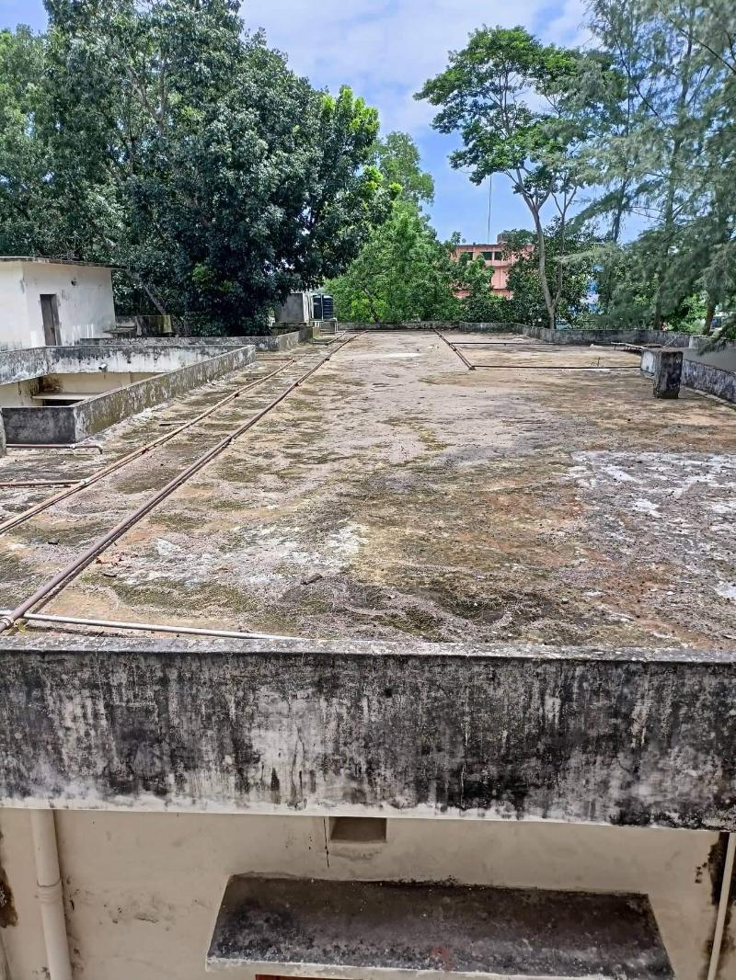
Roof of UHC Building
Before
After

Slide 17
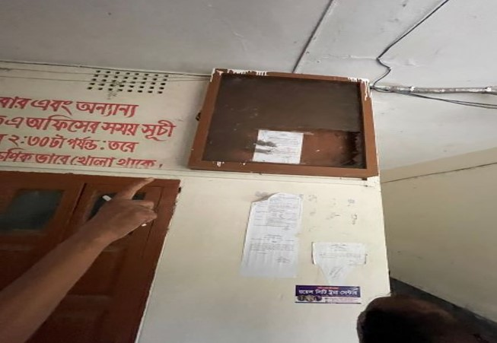
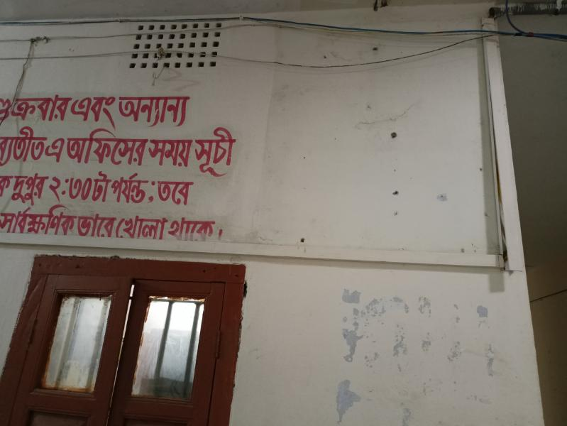
Notice Board of UHC
Before
After

Slide 18
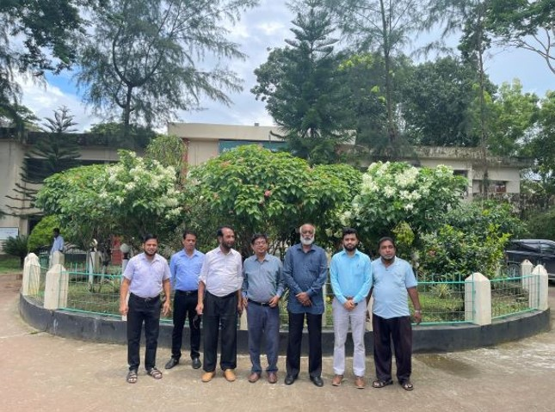
Garden in front of the UHC

Slide 19
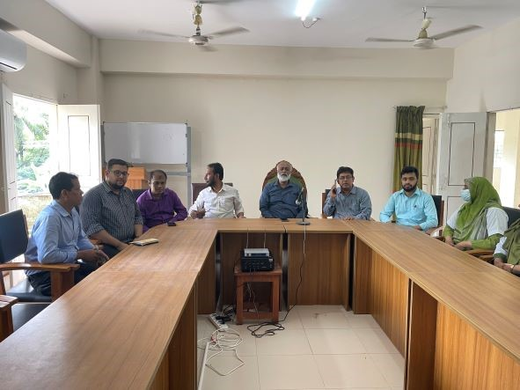
Conference Room of Bamna UHC

Slide 20
Upazila Health Complex
BAMNA, BARGUNA.
Community Support
Two IPS donated by Local MP.
Dental Doctors Room was Decorated by Upazila Parishad.
X-Ray room was well established by Upazila Parishad.
Blood donated about 85 units by blood donors in emergency need.

Slide 21
Achievement of Bamna Health Complex
* In 2012, Bamna Health Complex declared as the 50 Beded in Bamna upazilla health complex.
  Mobilized 7 additional workers from community (2 volunteer, 3 cleaners and others 1).
  EOC Beds 05
  Bamna UHC achieved MDG target in 2009.
  Bamna Health complex is awarded for best performance in HSS.
  COVID Achievement
  0% Mortality in Bamna Hospital
  Regular OPD Rx, Hospitalization With Proper Max in Covid Unit& Proper Referral.
  Successful Covid Vaccination (72%) in Bamna Upazila.
  Pathological Tests , ECG, X-Ray & USG is Available.

Slide 22

Thank You
Notes:
22

